Slide 1
Inference
Understanding paragraphs

Slide 2
Goals
I can identify the main idea of a paragraph
I can combine pieces of information given verbally to form conclusions
I can understand and answer questions about an information texts
I can make inferences from spoken paragraphs such as:
  Inferring how a character is feeling by imagining how I would feel in the same situation, or from the characters actions
  Inferring where/when according to activities being undertaken (opening presents – birthday or Christmas, talking to the teacher – at school)
  Inferring cause and effect – why something happened or why a character made a particular choice

Slide 3
Inference
A conclusion you reach that is based on evidence and reasoning.
Inference involves filling in the gaps by combining evidence (key words in the text) and reasoning (your experiences/schema).

Slide 4
Combine to answer question
Inference
Clues in text
(Key words)
Schema

Slide 5
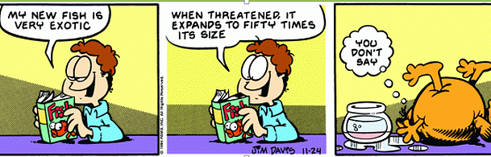

Slide 6
Inferring how a character is feeling
John watched the sprinters from a chair near the finish line. He glared at everyone else smiling. John stared at his leg in its cast and sighed.
Was John feeling happy?

Slide 7
Inferring where/when
Jess was dunked by its enormous force. Miraculously she surfaced. But just as Jess went to take a large gulp of air, a second wave hit her.
Where is Jess?

Slide 8
Inferring cause and effect
The roof paint was available in blue or green and Amber made her choice, knowing she wanted her house to blend in with the surrounding trees.
What colour did Amber choose?

