Slide 1
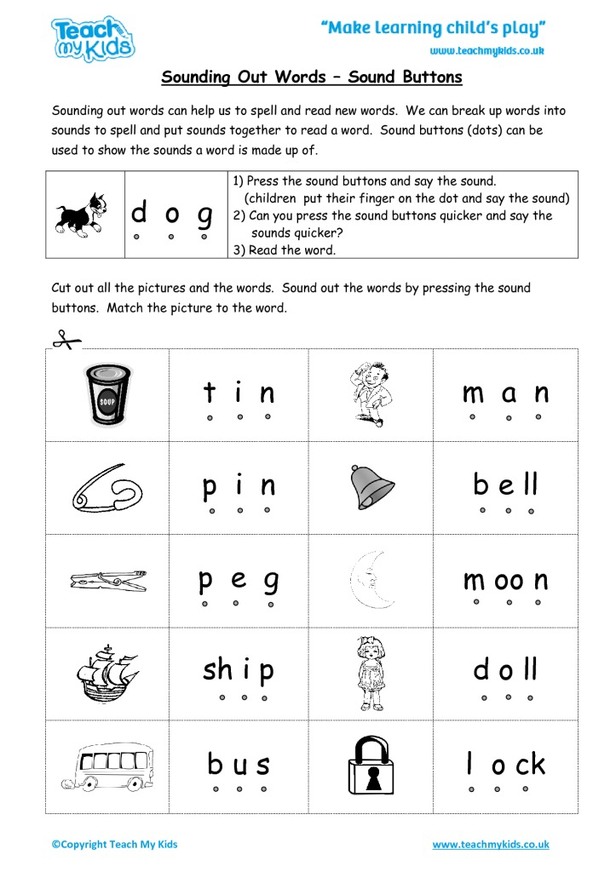
Blending sounds to read
Video link

