Slide 1
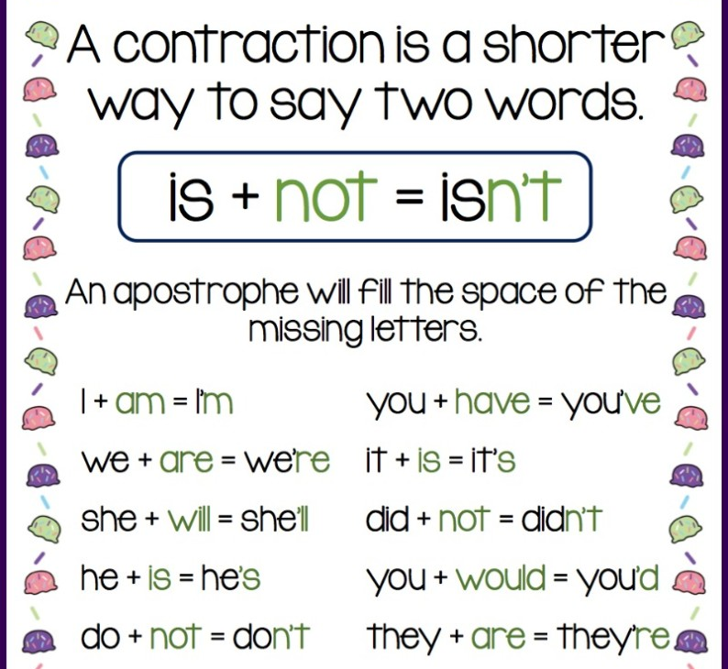
Contractions
Put an apostrophe where the missing letters are
Video link

Slide 2
Combine the 2 words to create a word with a contraction. Record or write a sentence for each word
Example: She has = she’s. She’s got 3 apples
Do not =
It is =
I am =
They are =
Would not =
We have =
He had =

Slide 3
List any other words with contractions you can think of. Who can come up with the most??
Example:
can’t

