Slide 1




Sentences with verbs
Read the verbs
Write a sentence about the picture
Make a video of you reading the sentences out loud
Instructions: Video link

Slide 2
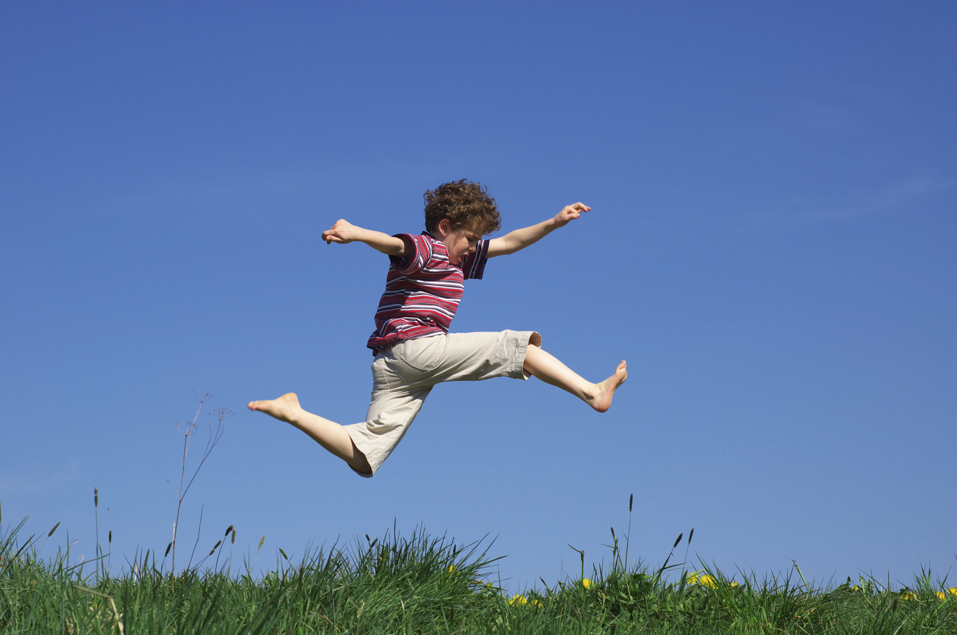
I can……
jump
skip
hop

Slide 3
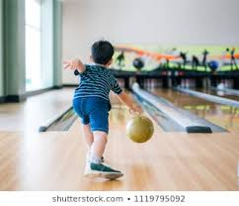
I can………
play
bowl
toss
throw

Slide 4
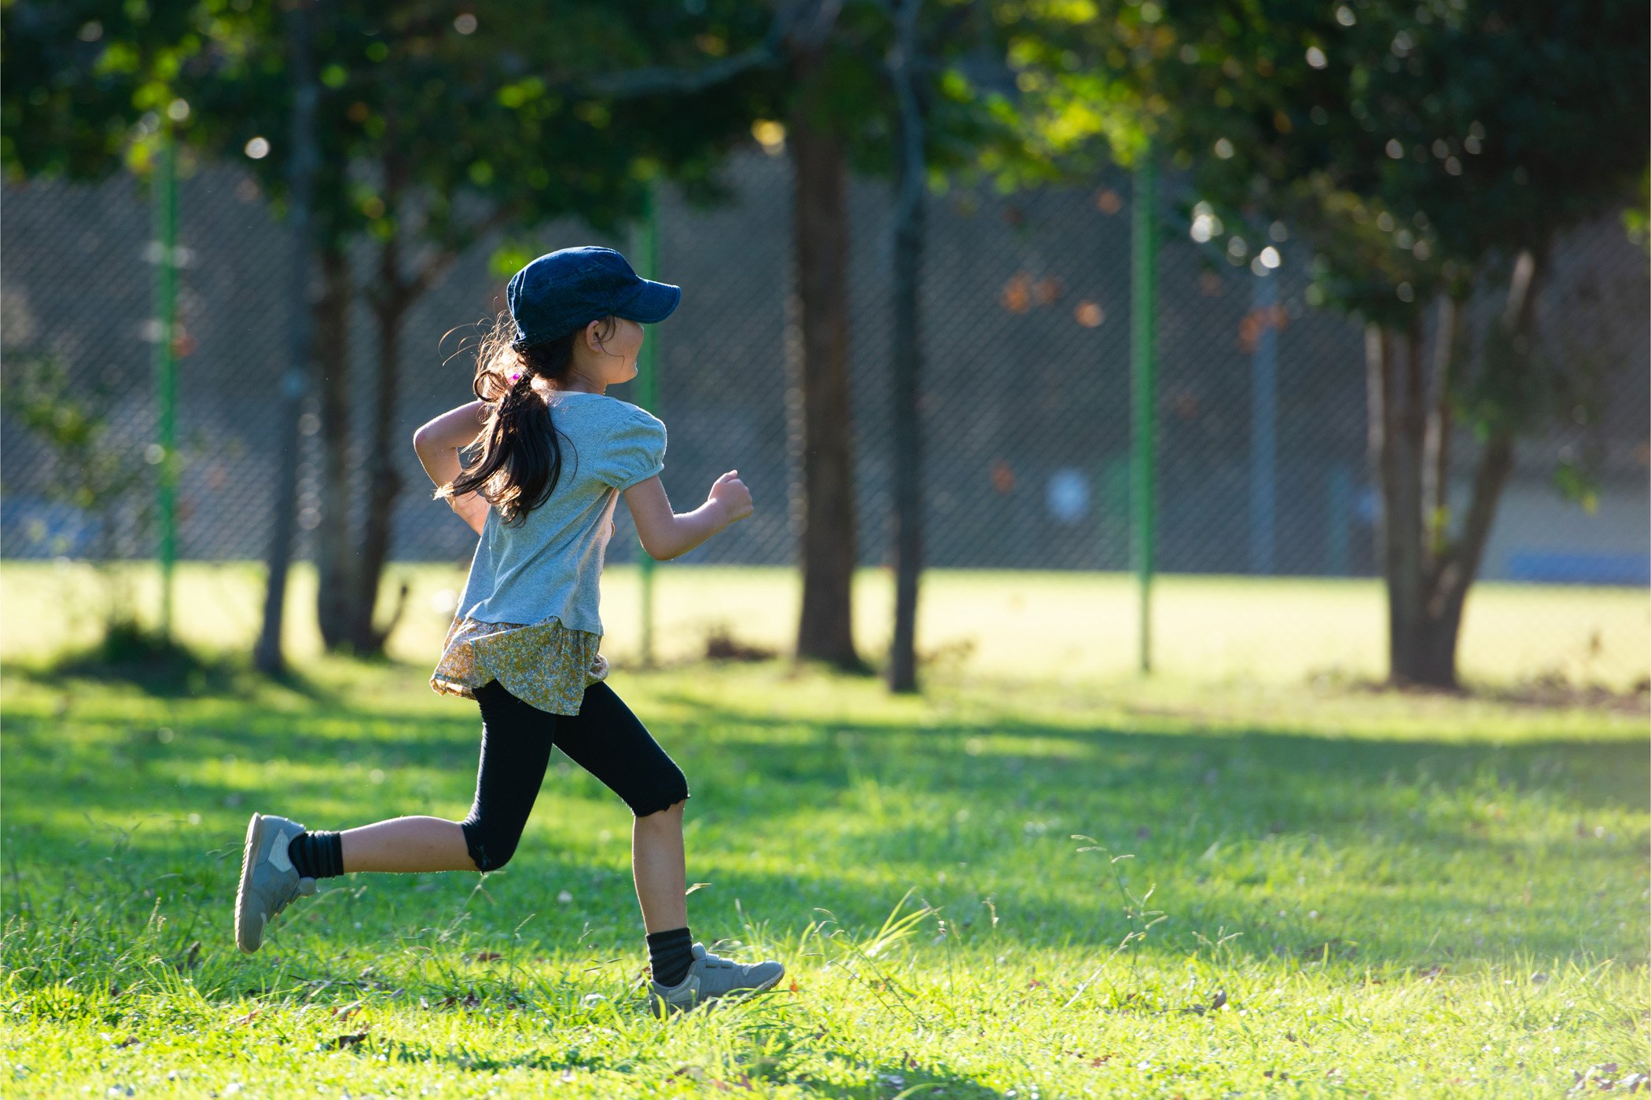
I can…………
run
jog

Slide 5

I can……..
smile
grin
sit

Slide 6
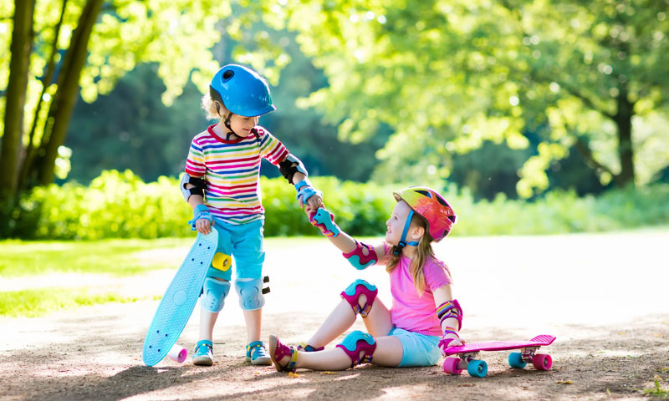
I can……..
help
lift
fix

